Slide 1
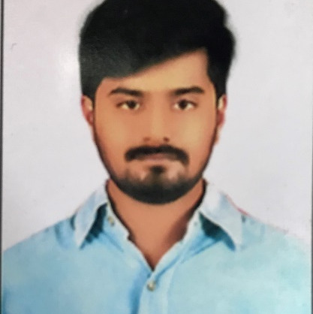
Hemanth Kumar Reddy Venkata Sai Pala
Analyst/Software Engineer
Bachelor of Technology, Computer Science and Engineering : 2016 - 2020
Skills
C# | Oops, Exception Handling, Inheritance, Collections, Delegates and Generic
.Net Framework | ADO.NET with Entity Framework And LINQ,ASP.NET with MVC5
Ado.Net | Basics, Connected and Disconnected Architecture
Database | Sql Server Management Studio
UI Technology | HTML , CSS
Tools | GIT, GitHub, Postman, Swagger
Add On Skills | Communication , Team Management
Bangalore
hemanth-kumar-reddy.venkata-sai-pala@capgemini.com
+91 7893976062
A4
Full Stack Developer
. Git and GitHub
SQL and RDBMS
C# Intermediate
ADO.net, Entity framework, LINQ.
ASP dotNet Core Web App(MVC)
Asp dotNet Core Web API
HTML, CSS , JavaScript , Typescript
Angular
Certification on Exam AZ-900: Microsoft Azure Fundamentals
Certification on Agile Software Development
Created a Online Shopping Cart Application With MySQL Backend and WebAPI Core as middleware and Angular as frontend Used HTML, CSS and TypeScript for the designing.
Check Out the full Project With Code On My GitHub.

